Slide 1
Enterprise Payment System (EPS) 2021 Industry Sessions

Slide 2
Agenda
1. Enterprise Payment System (EPS)
2. Permits and Migration
Supported Products
Products that need USPS Assistance
Unsupported Products
3. Commercial Mailings on EPS
Account Set-up
Transactions
4. Enterprise Payment Resources
Notes:
This is an ongoing series of webinars we are offering to commercial customers on a bi-weekly basis. On today’s agenda we are going to touch upon Enterprise Payment System aka EPS. Permits and Migration. We’ll go over our supported products, products that will need USPS assistance and our unsupported products. We’ll go over Commercial Mailings on EPS and what the Account Set-Up looks like and then go over some Frequently Asked Questions. We’ll also share where customers can get additional Enterprise Payment information from.

Slide 3
CAPS Closeout Plan
Centralized Account Processing System (CAPS) will retire October 2021. All customers with CAPS accounts need to migrate to Enterprise Payment System (EPS) as soon as possible to prevent loss of the ability to mail within the Postal Service.
Customers with Parcel Return Service (PRS) or those waiting for the EPS showstoppers to be implemented on August 15th can still create an Enterprise Payment Account (EPA).
Customers that have not self-migrated by August 15th will be placed into inactive status and will have to contact the local BME, PostalOne! Helpdesk, or MSSC to place their account back in active status and migrate to EPS.
A detailed timeline follows on the next slide
Mail Entry & Payment Technology August 2020

Slide 4
CAPS Closeout Plan
August 15th
Inactivation of the following:
August 22nd
Inactivation of the following:
August 29th
Inactivation of the following:
Priority Mail
First-Class Mail, Letters, Cards, Flats, and Package Service
USPS Marketing Mail, Letters, Flats, and Parcels
Parcel Select
Media Mail
Library Mail
Bound Printed Matter
Periodicals
ACS™ and AEC
International Products
BRM/QBRM
iCAPS
Premium Forwarding Service Commercial (PFSC)
Premium Forwarding Service Local (PFSL) Commercial Package Intercept (CPI)
Click N Ship Business Pro (CNSBPro)
DFAS/SAM
eVS
Parcel Return Service (PRS)
Third-Party Billing (TPB)
Mail Entry & Payment Technology August 2020

Slide 5
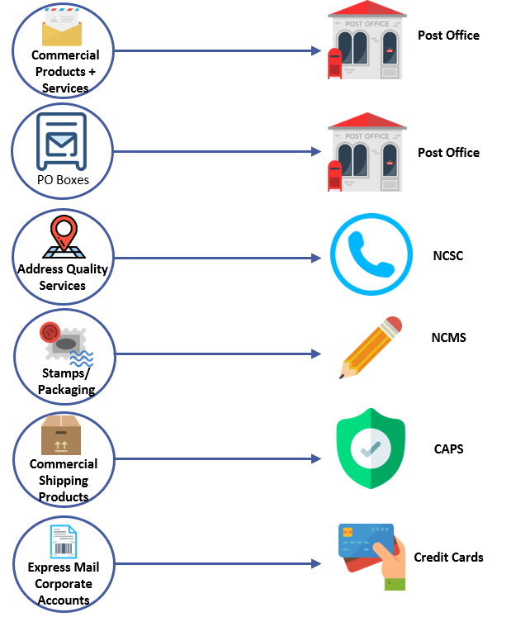
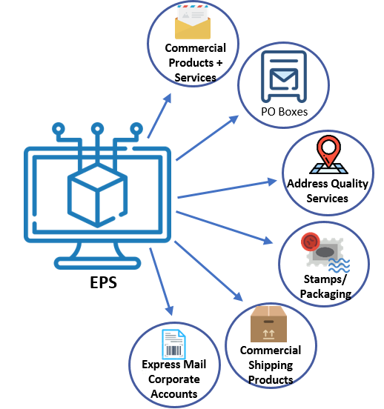
BEFORE
Enterprise Payment System (EPS)
AFTER
Why EPS?
Pay for all Products and Services with one account
Manage accounts online
Establish permits online
Manage postage spent
Convenient payment options
Notes:
Let’s take a closer look at what EPS can do for customers by taking a look at how eligible mail products and services were managed and paid, prior to EPS.
On the left of this slide, represents the various payment methods used prior to EPS. As you can see, customers were required to pay for various USPS products using different methods, which is quite a lot to keep up with.
Now, with an Enterprise Payment Account, Mailers have a single payment account which enables them to organize and consolidate payment for multiple USPS business functions in one location.
In addition to one convenient place to pay, EPS offers mailers flexibility in how and where payments can be made. This payment flexibility means you can choose to electronically manage your EPS account or choose to visit a designated retail location to deposit funding into your account.

Slide 6
USPS to Sunset CAPS October 2021
Supported Products Ready for Self Migration
Supported Products that need Additional HQ Support
iCAPS*
Defense Finance & Accounting Service (DFAS)*
System for Award Management (SAM)*
PC Postage*
Express Mail Corporate Account is currently being transitioned to National Customer Management System (NCMS)* https://postalpro.usps.com/sfs/emca-migration
Priority Mail First-Class Mail, Letters, Cards, Flats, and Package Service USPS Marketing Mail, Letters, Flats, and Parcels Parcel Select Media Mail Library Mail Bound Printed Matter Periodicals Premium Forwarding Service Commercial (PFSC) Premium Forwarding Service Local (PFSL) NEW! | International Products Third-Party Billing (TPB) BRM/QBRM eVS/CNSBPro USPS Returns** PC Postage/Endicia* DFAS/SAM* iCAPS* Pitney Bowes customers using only the products above Commercial Package Intercept (CPI) NEW!
Steps to Complete before Escalating to USPS
iCAPS, DFAS & SAM Mailers
-Establish EPS account
-If EPS account already established, determine if permit should be linked or if new account should be established
-Once EPS account is established, reach out to Local BME or MSSC for escalation to EPS Team
-Provide Contact Information & EPS Account Number
PC Postage Mailers
-Establish EPS account
-If EPS account already established, determine if permit should be linked or if new account should be established
-Steps to link permit vary upon postage vendors
-Reach out to Vendor if steps have not been provided
-Refer to EPS PC Postage Fact Sheet
Pitney Bowes Mailers
-Reach out to your Pitney Bowes Rep
-If you need additional assistance, reach out to Local BME or MSSC
**Merchandise Return Service (MRS) and Scan Based Payment (SBP) was retired on August 28, 2020. MRS/SBP customers was migrated to USPS Returns and EPS.
Supported Permits for the above list of products:
Permit Imprint (PI)
Postage Due (PD)
Business Reply (BR)
Periodical (PE)
Notes:
The USPS is currently in the process of outreaching to our CAPS customers to migrate to EPS. Customers who have 100% supported products should initiate the onboarding process.
To the left of this slide, we can see the supported products ready for self-migration. Priority Mail, FCM, USPS Marketing Mail letters and flats, Parcel Select, Periodicals and Premium Forwarding Service Commercial to name just a few.
To the right we have supported products that requires USPS Headquarters assistance. And these are: iCAPS, Defense Finance & Accounting Service (DFAS), System for Award Management (SAM) which are government programs, and also PC Postage.
Express Mail Corporate Account customers will be transitioned to the National Customer Management System (NCMS) since EPS does not support this particular product. Also, EPS does not support Merchandise Return Service (MRS) and Scan Based Payment which were retired on August 28, 2020. MRS and Scan Based Payment customers were migrated to USPS Returns which is completely supported by EPS.
EPS can be used on the following types of permits: Permit Imprint, Postage Due, Business Reply, Periodical and Pending Periodical.
If you happen to fund your postal accounts through Pitney Bowes, please note you will need to reach out to your Pitney Bowes Rep for assistance with this migration to EPS.

Slide 7
EMCA-CAPS Migration to EMCA-NCMS
Customers need to complete two steps to delink their EMCA from CAPS and establish NCMS payment for their EMCA
Step 1— Complete and sign the USPS PS Form 5639 and fax or mail to Stamp Fulfillment Service:
• Fax - (816) 545-1212
• Mail USPS Corporate Account
ATTN: USPS CA Coordinator
8300 NE Underground Dr. Pillar 210
Kansas City MO 64144-0001
Step 2— Email a letter to the CAPS team requesting to de-link your EMCA from CAPS; see sample letter is below:
• Email the letter to SSMCTAS@email.USPS.Gov with the Subject “EMCA De-Link Request CAPS XXXXX”
• The letter can be in word or PDF format and must be on the company’s letter head
• Make the effective date for CAPS de-linking 10 business days after you submit your PS 5639 form
Support
• Customers will not experience EMCA payment or PME service disruption related to this change
• PME charges that did not go through CAPS will be charged by NCMS once the PS 5639 form is processed
• If you have questions on completing the PS 5639 from, please contact our helpdesk at 1-844-737-7826
7
Notes:
Customers who currently have Corporate Express Mail accounts linked to a CAPS account need to migrate to the National Customer Management System (NCMS). Customers need to complete two steps to delink their EMCA from CAPS and then establish NCMS payment for the EMCA.
You would need to complete and sign PS Form 5639 and fax or mail it to USPS Stamp Fulfillment. Then you would need to email a letter to the USPS CAPS team requesting to de-link your EMCA from CAPS. The effective date for this de-linking should be 10 business days after you submit your PS Form 5639.
Please note that customers will not experience EMCA payment or PME service disruptions related to this migration.
PME charges that did not go through CAPS will be charged by NCMS once the PS Form 5639 is processed.
If you have any questions or concerns about this form or this process please contact 1-844-737-7826.

Slide 8
Commercial Mailings on EPS – Account Setup
Get Ready!
Create BCG Account
Request EPS
Create EPS Account
Set-up Payment
Link Permits/ Publications
Go to “Other Services” tab on your BCG Account
Select “Get Access” on the “Enterprise Payment System” Tab
Create an Enterprise Payment Account (EPA)
If customer does not know CAPS Pin Number, have them create new account
CAPS is 5-digit account number
EPS is 10-digit account number
Set up the selected payment option: ACH Debit (ensure there are no fraud filters on account) or Trust via EFT, Retail Deposit or Mobile Deposit
Activate your payment method
Link your mailing Permits to your EPA
Choose the best payment option for your organization
Get a list of all your active permits
Register for a Business Customer Gateway (BCG) Account
Customers already registered skip to the next step
Notes:
Here is just an overview of the steps a customer needs to take to set up an EPS account.
Mailers should have a list of all of their active permits that need to migrate from CAPS to EPS. This is very important especially if you are a CAPS Trust customer, because in order for your entire balance to transfer over from your CAPS Trust account to your new EPS Trust account, all permits that are tied to the CAPS Trust must be linked to the EPS trust account in order for that balance to transfer over.
Once you have a complete list of all permits you will need to create a Business Customer Gateway (BCG) account (if you do not already have one). Make sure that you already have access to all permits and CRIDs you are looking to migrate to EPS before moving forward with the migration. Customers will need to request access to EPS under the “Other Services” tab in the BCG. Select “Get Access” on the “Enterprise Payment System” tab and you’ll see the request turn to “Pending Helpdesk.” Once the PostalOne! Help Desk grants your access to EPS you’ll be able to click into the EPS portal of the BCG.
Please note: Whoever requests access to EPS first will become the BSA (Business Service Administrator) on the account. And once the BSA is established then all other users can request access and these requests would be escalated to the BSA for approval.
4. Once the Help Desk approves your request, you’ll be able to click into the EPS portal and create the Enterprise Payment Account. From here, customers will see the option to either put in their CAPS Pin # or just create a new account. Please note, that customers do not need to know their CAPS Pin # to open an EPS account, this is only an option to customers if they want to keep the same (or similar) account # moving forward.
Then you will select your payment option. Simply put there are two options for customers: ACH Debit and Trust. If a customer chooses the ACH Debit option, they will link their business checking account and mailings will be debited from their postal permits. If a customer chooses the Trust option, they can make deposits at a USPS Retail counter or through a Mobile deposit (via a Wells Fargo app). The trust option also offers an Electronic Funds Transfer (EFT) option, so customers can Fedwire money over to their EPS account as well. After selecting your payment method option, you will be issued a 10-digit EPS account # which you should write down.
Two things to note: if you are choosing the ACH Debit option please work with your bank and let them know you are looking to link your account to a USPS permit. Sometimes banks will have fraud alerts or detections which will make this migration unsuccessful without this fraud alert deactivated. You might have to give your bank our USPS Company Identifier # which you can find on the EPS fact sheet posted on PostalPro.
The other thing of note is, every customer that chooses the ACH Debit payment option will by default also receive an EPS Trust account as well. It will be up to the customer if they would like to activate the Trust functionality on their account by making a deposit at a USPS retail location.
Once you establish your EPA # your next step is to “activate” the EPS account. If a customer chooses the ACH Debit option they will need to monitor their business checking account for two small micro-transactions. It may take up to 24 to 48 hours for them to receive the micro debits. Once they receive those small micro-transactions (that would be under $1) they would need to validate these amounts in the EPS portal of the BCG. If they choose a EPS Trust account, they will need to “activate” their account by going to their Local Post Office (LPO) and making a small deposit into the 10-Digit EPS account (not their permit).
Once the account is activated then you will need to log back into the BCG, click into the EPS portal and then actually link the EPS account to your various permits. Once you save those linkages your EPS migration would be complete.

Slide 9
Commercial Mailings on EPS – Transactions
Submit Postage Statement
Present Mailing
Process Mailing
Finalize Mailing
Withdraw Payment
View Mailing Reports
Submit postage statement* electronically using mail.dat, mail.xml or Postal Wizard, or via hardcopy at BMEU
Present mailing at USPS facility
Action recorded in PostalOne!
Payment transaction sent to EPA
Payment withdrawn from EPA
Mailing reports viewable in BCG and EPS
ACH Debit transactions are aggregated and deducted at 6PM EST daily.
Permit/publication number field: Enter permit/publication number in eDoc
Account number field: Optional, but must match the account number linked to the permit number
Mail Anywhere: EPA number will replace National account number
Notes:
This slide illustrates the different stages of a commercial mailing being paid through an EPS account.
The customer will submit a postage statement entering the correct permit or publication number in their documentation. In the Account Number Field of their eDoc they should indicate the account # associated to the permit #. In a Mail Anywhere scenario, the EPA # will replace the national account # you used to populate.
Then you would present the mailing at a USPS Facility. The mailing would be checked in, processed and finalized.
Once USPS Acceptance Personnel finalize the mailing the payment transaction is sent to the Enterprise Payment Account (EPA).
If you are an EPS Trust account this payment is withdrawn immediately. But if you are an ACH Debit account, all transactions are aggregated and deducted at 6pm EST daily.
From there, customers have a multitude of reports they can view and pull from the BCG and EPS to keep track of all of their financial transactions with the USPS.

Slide 10
Key Points:
EPS
ACH Debit accounts are the required method of funding an eVS permit through your EPS account per Publication 205 Electronic Verification System (eVS®) Business and Technical Guide.
NOTE: Existing eVS CAPS Trust Accounts can migrate unchanged over to EPS.
Trust balances will automatically transfer to the EPS trust account upon linking of the permit.
NOTE: If a CAPS trust account is involved the balance will transfer only after ALL permits and services linked to that CAPS account have been migrated to EPS.
ACH Debit transactions are aggregated and deducted at 6PM EST daily. Individual transactions are available through the reports section of the EPS account.
NOTE: Customer Bank statements will only show the aggregated total deduction for each day.
Notes:
Here are some key points related to EPS.
ACH Debit accounts are the required method of funding an eVS permit through your EPS account per Pub 205 Electronic Verification System (eVS®) Business and Technical Guide.
NOTE: Existing eVS CAPS Trust Accounts can migrate without USPS intervention over to EPS.
Trust balances will automatically transfer to the EPS trust account upon linking of the permit. Remember, if a CAPS Trust account is involved, the balance will transfer only after ALL permits and services linked to that CAPS account have been migrated to EPS.
ACH Debit transactions are aggregated and deducted at 6PM EST daily. This is a major difference from CAPS transactions which were aggregated at midnight daily. So, if you present a mailing at a BMEU at 7pm – that mailing will not reflect in your EPS account/business checking account until the following day after 6pm EST.
When I say I aggregated, I mean customer bank statements will only show the aggregated total deduction for each day – not the individual mailings for that day. But note, that individual transactions can be found in the reports section of EPS.

Slide 11
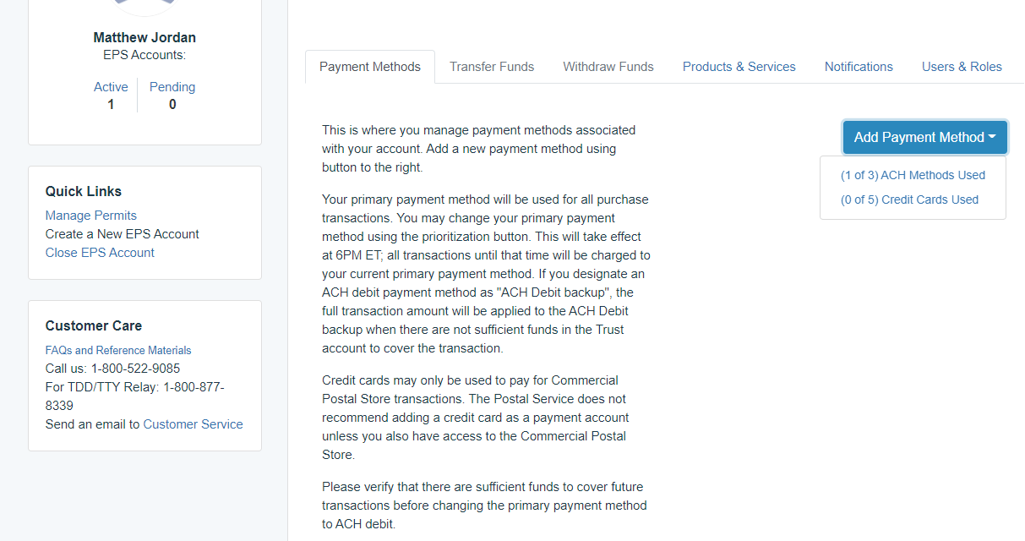
Who can use the credit card payment method?
Only Commercial Postal Store customers are able to use the credit card method.
Notes:
Here is a commonly asked question: Who can use the credit card payment method?
As we all know, commercial mailers cannot pay postage with a credit card which means only Commercial Postal Store customers are able to use the credit card method when setting up their EPS account.
Please be careful if you are self-migrating to EPS; the BCG will allow you to choose the credit card option as a payment method but when you try to link your permits you will be unsuccessful and you will have to start the migration process over with a new EPS account #.

Slide 12
How can a mailer change their bank account information?
Mailers must update the payment method by selecting the Add Payment Method function.
Mailers only have 3 ACH Methods per EPS account
The Mailer will have to re-verify the micro-debit transactions for the new account.
Notes:
How can a mailer change their bank account information?
Let’s say your company decided to switch banks after you have already linked your account to your EPS account/permit. Mailers have the ability to attach 3 ACH banking methods to each EPS account.
Mailers would log into the EPS portal and update the payment method by selecting the “Add Payment Method” function and populating the new banking information.
Please note that customers will have to re-verify the micro-debit transactions for each new account they link.

Slide 13
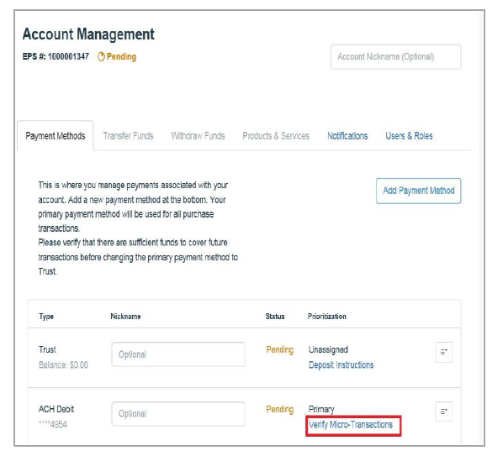
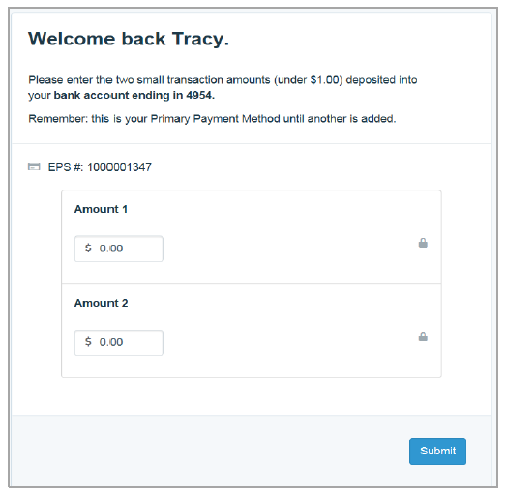
Micro-Debit Transactions
Micro-debit transactions are same schedule as normal debit - go out nightly, expected 1-2 business days to show up on the customer's bank account.
There's no time limit on verification.
Schedule a follow-up with Local BME
Notes:
Here is a slide that shows you where you would go to verify your micro-transactions to validate your EPS account.
Please note, micro-debit transactions are scheduled as normal debits. They would go out nightly and expected to hit a customer’s bank account within 1-2 business days.

Slide 14
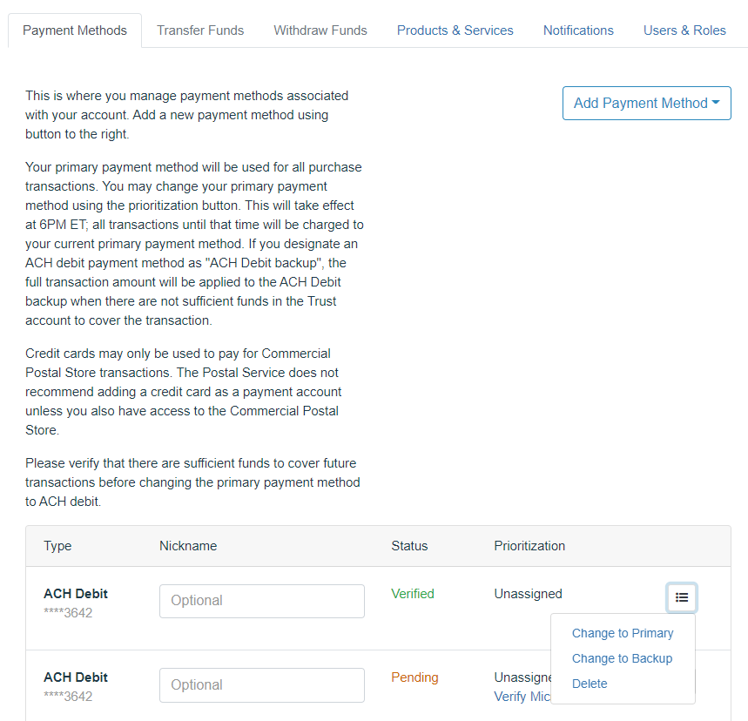
ACH Debit
Notes:
If you choose to link multiple business checking accounts to your EPS account you must set one account as your “Primary Payment Method.”
You can change your primary payment method using the Prioritization button. Note that this will take effect at 6pm EST, meaning all transactions up until that time will be charged to your current primary payment method. It won’t be until after 6pm EST, that the new account will take on any new transactions.
Mailers can also designate an ACH Debit payment method as an “ACH Debit Backup” – meaning the full transaction amount would be applied to the ACH Debit Backup when there isn’t sufficient funds in the Trust account to cover the transaction.

Slide 15
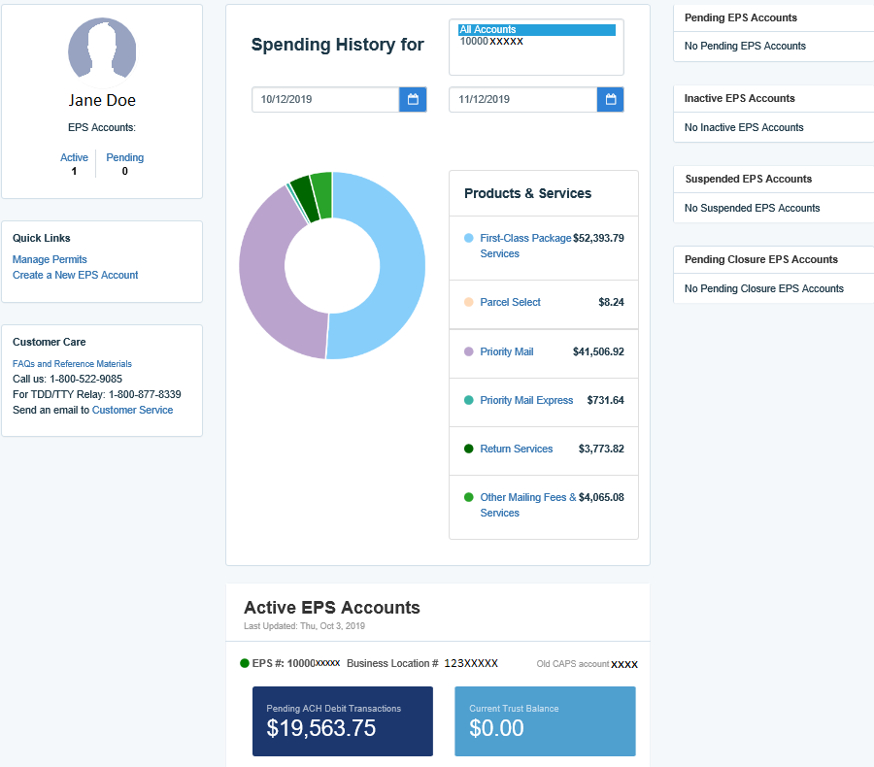
EPS Reporting Features:
EPS Migration
“EPS Dashboard” provides a
quick glance of all EPS accounts
and Real-time total spending
history grouped by products
and services.
Real-time total of “Pending ACH Debit
transactions sent to the bank at the end
of the day and current Trust Balance on
each active EPS Account.
ACH Debit Transactions are aggregated daily at 6PM EST
CAPS Transactions were aggregated at midnight daily
Notes:
Here is an example of what the “EPS Dashboard” looks like. It provides a quick glance of all EPS accounts and real-time total spending history grouped by products and services.
It shows real-time totals of “Pending ACH Debit transactions sent to the bank at the end of the day and the current Trust Balance on each active EPS Account.

Slide 16
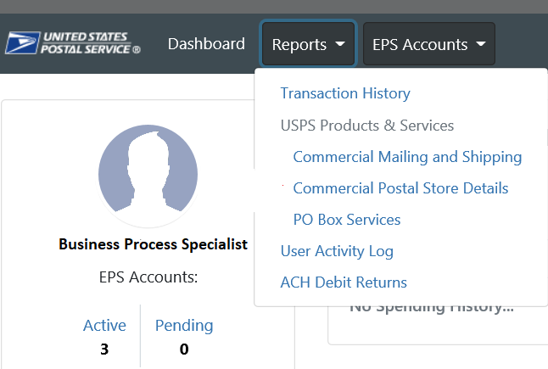
EPS Reporting Features:
EPS Migration
“Reports” tab gives access to:
Transaction History
Commercial Mailing and Shipping Activity
Commercial Postal Store Details
PO Box Services
ACH Debit Returns
User Activity log
Notes:
And here is where those Reports are in the EPS portal.
The Reports tab gives access to:
Transaction History
Commercial Mailing and Shipping Activity
Commercial Postal Store Details
PO Box Services
ACH Debit Returns
User Activity Log

Slide 17
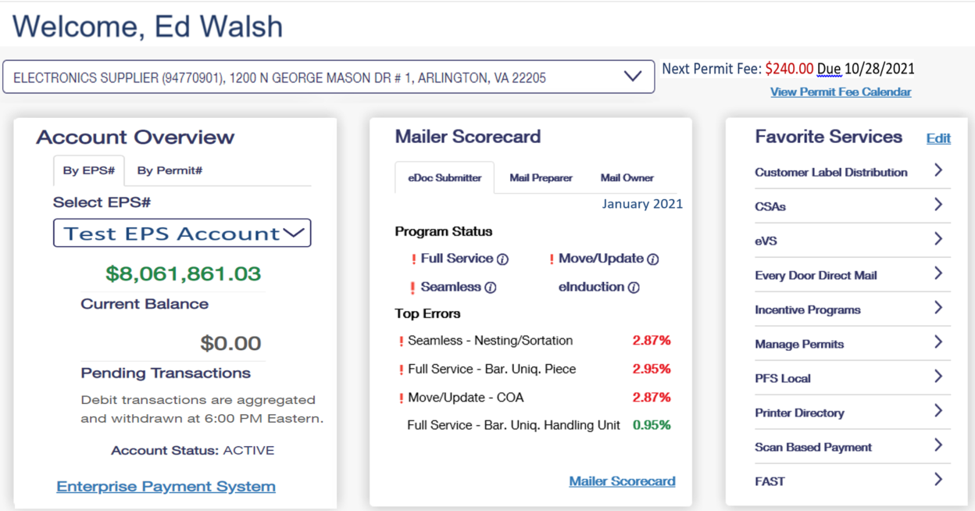
Business Customer Gateway – New Landing Page
Notes:
This slide is just showing what the new BCG landing page looks like. It’s been a few weeks since this update was made so you are probably already getting used to this new layout. From here you can see a snapshot (or widget if you will) of your EPS account, Mailer Scorecard and your Recent Mailings.

Slide 18
Enterprise Payment Services - Resources
Local BME
To locate your local BMEU follow this URL: https://postalpro.usps.com/ppro-tools/business-mail-entry
MSSC Help Desk
Support customers with EPS set up and use
MSSC@usps.gov
1-877-672-0007
Monday – Friday, 7am – 7pm CST
PostalPro
Provide online reference materials
https://postalpro.usps.com/eps
Notes:
We are coming to the close of our presentation. Here you will see where you can find additional resources to help you migrate your accounts to EPS.
Your local Business Mail Entry (BME) office has extraordinary individuals who are well-versed in EPS that can assist you in your migration.
The Mailing & Shipping Solutions Center (MSSC) is a help desk staffed with well-educated Mailing Requirements Clerks that can get you started on your EPS migration. You can email them at MSSC@usps.gov or give them a call at 1-877-672-007 – Monday through Friday from 7am-7pm Central Standard Time.
You can also find numerous fact sheets, user guides and supplemental information regarding EPS at PostalPro.USPS.com

Slide 19
Questions?
Notes:
Now, at this time, I would like to open it up for questions…

Slide 20
APPENDIX

Slide 21
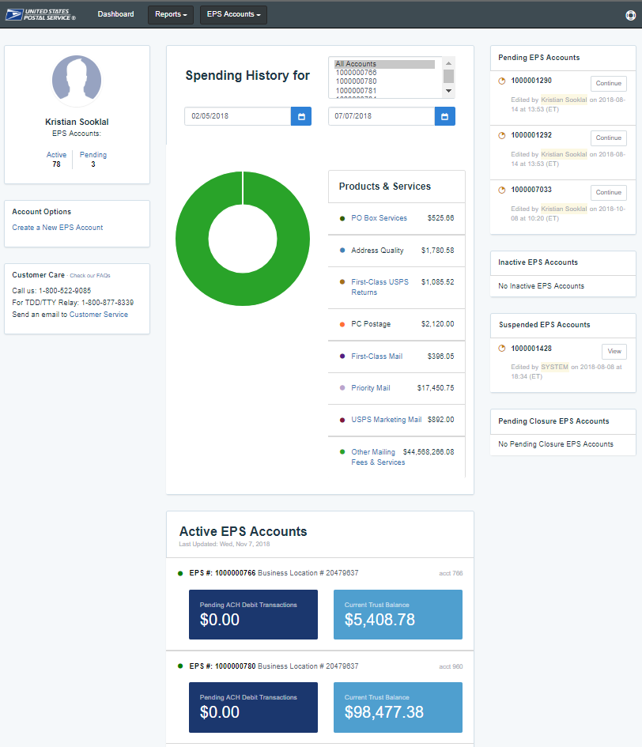
Commercial Mailings on EPS – Reports
Customer Dashboard provides a quick glance of all EPS accounts:
Pending EPS Accounts section shows EPS accounts for which the account setup process needs to be completed
View the real-time total Spending History overview for all EPS Accounts, grouped by Products & Services
View the real-time total of pending ACH debit transactions sent to the bank at the end of the day and the current Trust Balance, per Active EPS Account
Notes:
Two general routes:
1 - Select an Account (by clicking one of the boxes on the screen or using “EPS Accounts” dropdown on top menu bar) – this will take you to Account Summary page
2 - Select the “Reports” link from top menu bar to see a list of available reports.

Slide 22
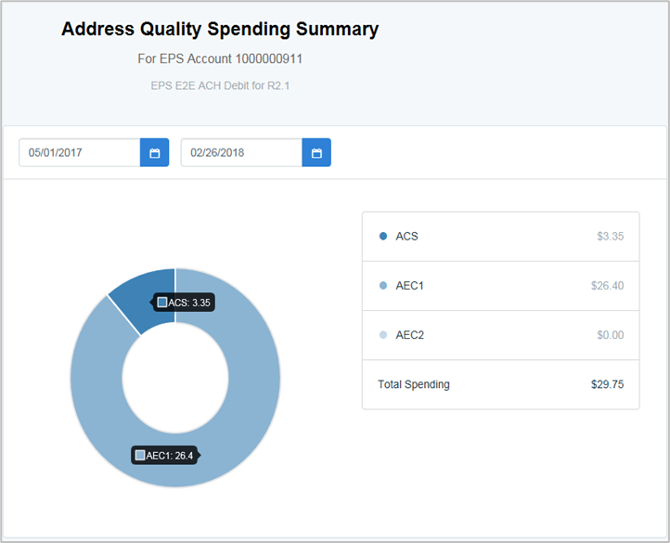
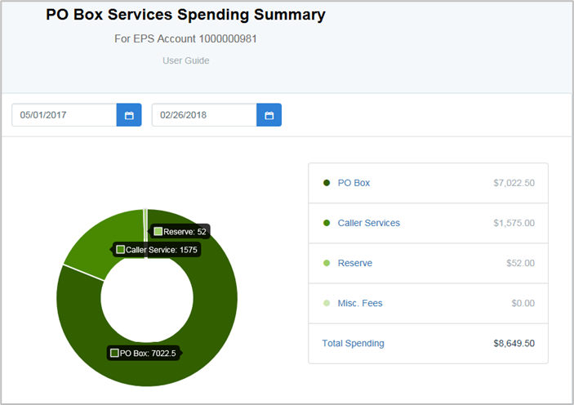
Commercial Mailings on EPS – Reports
Address Quality Spending Summary provides a breakdown of Address Quality spending by product (ACS, AEC1, AEC2).
PO Box Services Spending Summary provides a breakdown of PO Box Services spending by product (PO Box, Caller Services, Reserve, Miscellaneous Fees).
 | PO Box Services | $375.00
 | Permit Mailings | $947,317.75
 | Address Quality | $546,925.36

Slide 23
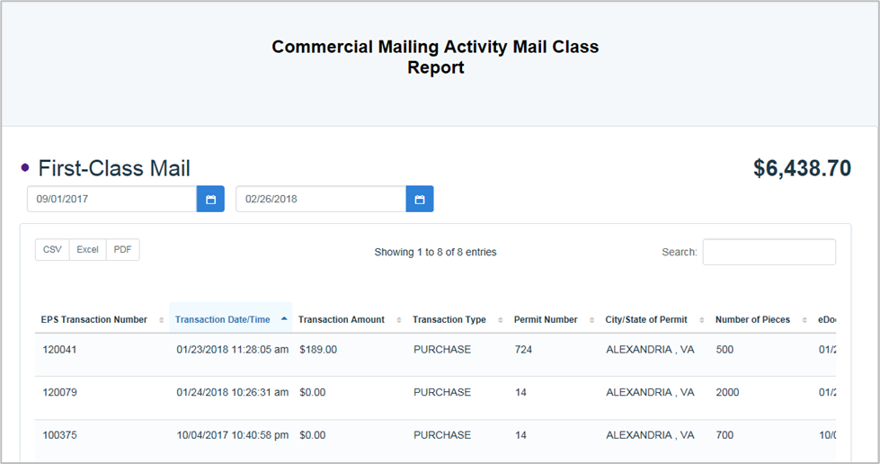
Commercial Mailings on EPS – Reports
Commercial Mailing Activity Mail Class Report summarizes transaction information for the selected Mail Class.
Notes:
EPS Transaction Number
Transaction Date/Time
Transaction Amount
Transaction Type
Permit Number
City/State of Permit
Number of Pieces
eDoc Mailing Date
Postage Statement Number
EPS Account Number
Job ID
Customer Reference ID
Permit Holder CRID
ZIP of Verification
Publication Number
User License Code
Class
Number of Copies
Spoilage
EPS Account Nickname

Slide 24
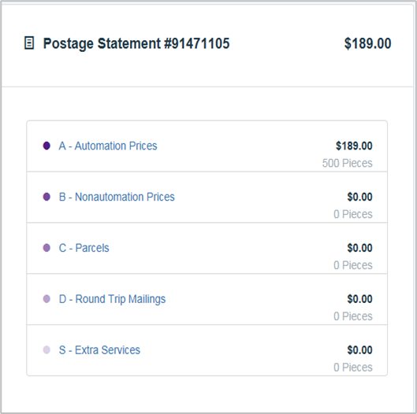
Commercial Mailings on EPS – Reports
Postage Statement Report summarizes the total cost by section of a specific Postage Statement drilled by clicking on the Postage Statement ID from the Customer Mailing Details Report.
Notes:
Click on a section to see the line level detail

Slide 25
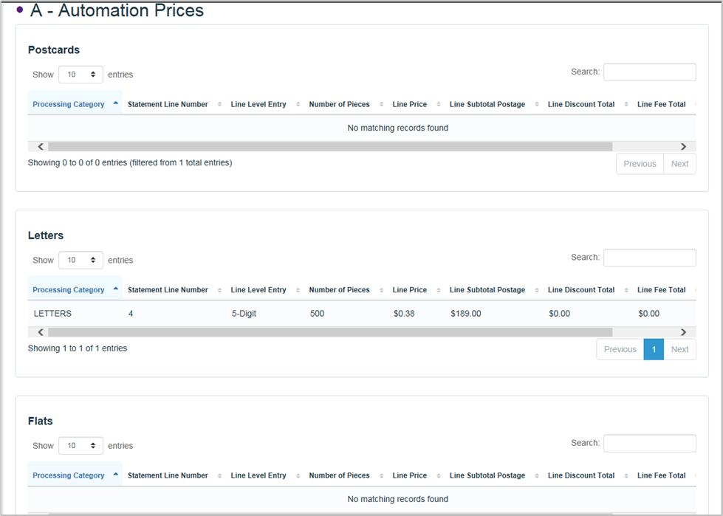
Commercial Mailings on EPS – Reports
Postage Statement Line Detail summarizes the total cost by line of the Postage Statement section selected on the previous page.
Notes:
Report features:
Sort by any column
Real-time search (results update after each keystroke)
Change # of records shown per page

Slide 26
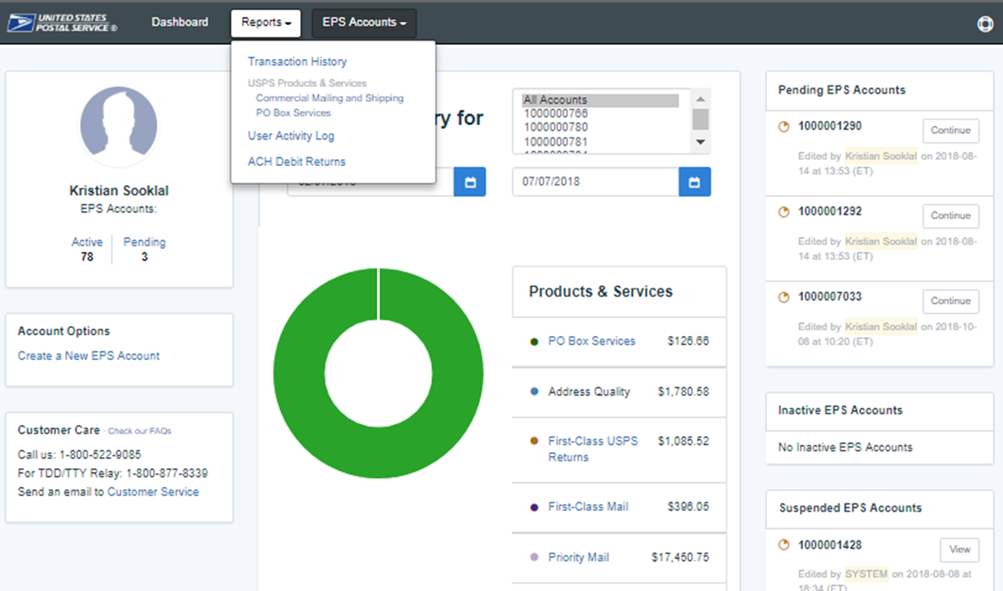
Commercial Mailings on EPS – Reports
Access various data providing information on:
Overall spending
Commercial Mailing and Shipping Activity
PO Box Activity
ACH Debit Returns
System activity

Slide 27
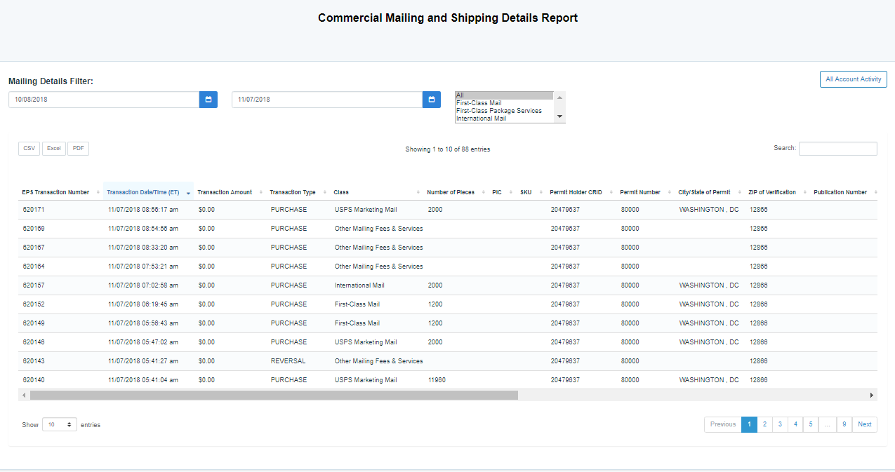
Commercial Mailings on EPS – Reports
Commercial Mailing and Shipping Details Report provides detailed information of shipping details and PostalOne! mailings.
Search results that filter real-time as you type across all columns
Report Data Fields
EPS Transaction Number Transaction Date/Time (ET) Transaction Amount Transaction Type EPS Account Number EPS Account Nickname Class Number of Pieces Permit Holder CRID Permit Number Permit Type Publication Number
City/State of Permit Mailing City Mailing State ZIP of Verification Customer Reference ID Job ID User License Code Spoilage Number of Copies eDoc Mailing Date eDoc Submitter CRID eDoc Submitter CRID Company Name
Postage Statement Number
PIC
SKU
Unique Package ID
EFN
Manifest Package ID
Assessment Type
Monthly Adjustment ID
Assessment Details
Unused Label Fee Amount
0
Notes:
Report features:
Filter by date range (default is one month; data is expected to be available for 2 years)
Sort by any column
Real-time search (results update after each keystroke)
Change # of records shown per page
Download results to CSV, Excel, or PDF

Slide 28
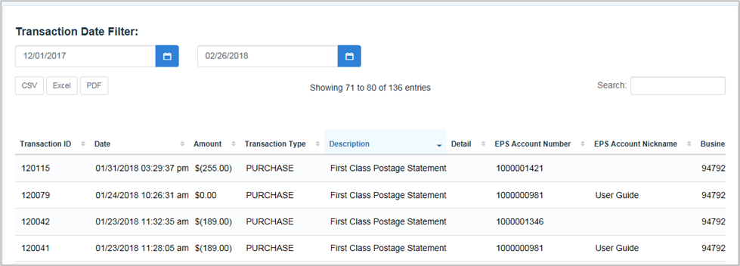
Commercial Mailings on EPS – Reports
Transaction History Report summarizes the transactions that were made within a selected timeframe.
Notes:
Trans Id
Date
Tran Type
Description
Product Id
Business Location
EPS Account Number
EPS Account Nickname
Payment Method
Amount
Original Trans ID

